Slide 1







TECHNOLOGY TREND ANALYSIS
ENETOMHE CORNELIUS
23/01/24

Slide 2



OUTLINE
• Executive Summary
• Introduction
• Methodology
• Results
• Visualization – Charts
• Dashboard
• Discussion
• Findings & Implications
• Conclusion
• Appendix

Slide 3

EXECUTIVE SUMMARY
• Current Technology Usage Trend
• Language
• Database
• Platform
• Web frame
• Future Technology Trend
• Language
• Database
• Platform
• Web frame
• Demographics Survey
• Country & Gender Difference

Slide 4

INTRODUCTION
Analyze technology trends in software and web development among developers around the world
Purpose of this Analysis
• Identify the top programming languages, databases,
platforms and web frame skills that are in demand
• Identify skill requirements for future
• Identify the human resource gap in the industry
• Audience for this Presentation
• Programmers
• IT industry leaders
• Computer science students

Slide 5

METHODOLOGY
• Data Collection
• Stack Overflow Developer 2019 survey
• GitHub job postings
• Programming languages annual salary
• Data Wrangling
• Data Exploration
• Data Cleaning
• Data Visualization
• Python Matplotlib
• IBM Cognos
• Presentation

Slide 6
RESULTS

Slide 7
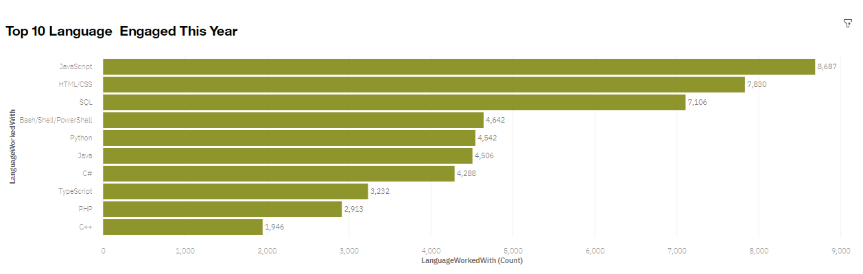
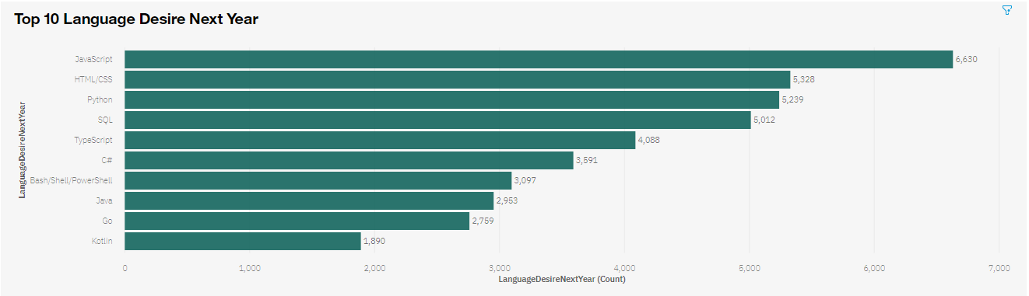
PROGRAMMING LANGUAGE TRENDS
Current Year
Next Year

Slide 8
PROGRAMMING LANGUAGE TRENDS - FINDINGS & IMPLICATIONS
Findings
JavaScript is top trending language in the world
Python and TypeScript are becoming more and more popular
HTML/CSS and SQL still has great portion in language usage trend
Implications
Web developments and Web developers are still in high demands
JavaScript and TypeScript are crucial to learn for developers
Python is the new trending language, especially popular in AI fields

Slide 9
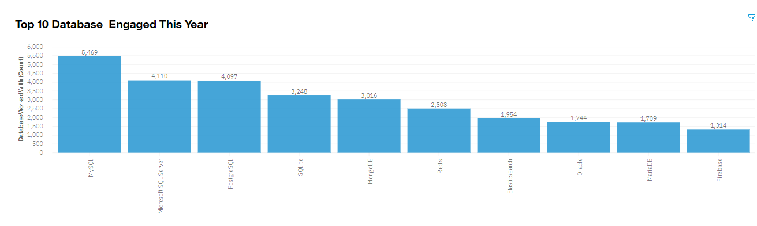
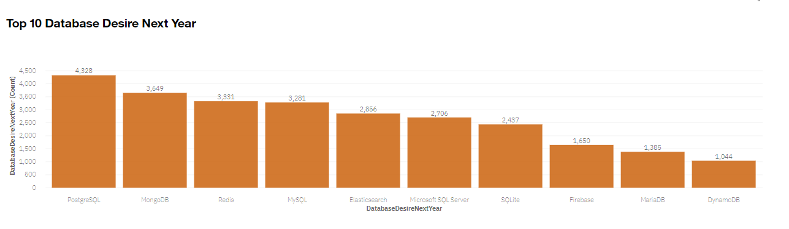
DATABASE TRENDS
Current Year
Next Year

Slide 10
DATABASE TRENDS - FINDINGS & IMPLICATIONS
Findings
MySQL is the most popular database
There are still a lot of companies using Microsoft SQL Server
MongoDB and Redis are the most favorable NoSQL database
Implications
Open-source databases like MySQL are still preferable
Software development and Big Data technology still require SQL
NoSQL databases will make an impact on relational databases

Slide 11

DASHBOARD
The permanent link of the read-only view of the Cognos dashboard:
https://dataplatform.cloud.ibm.com/dashboards/3fdb41d9-adfe-492f-87c5-b1289b6778b9/view/4f7fd406178b349715f3c0e4079824042f662209b3bbd15681837b495a637597a96e1795c87e1e5a8b180737f1eb405bc0

Slide 12
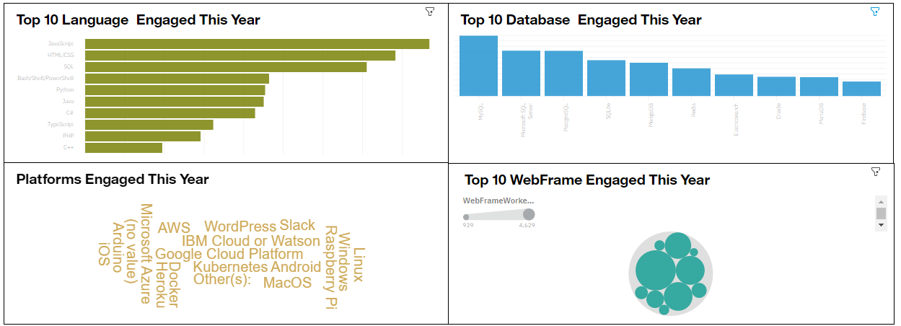
DASHBOARD TAB 1

Slide 13
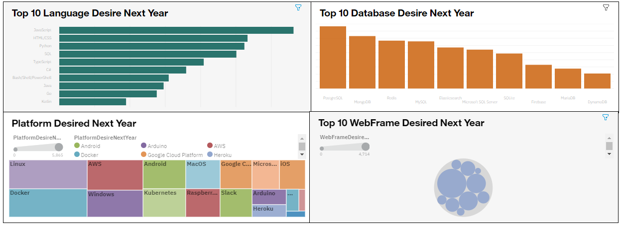
DASHBOARD TAB 2

Slide 14
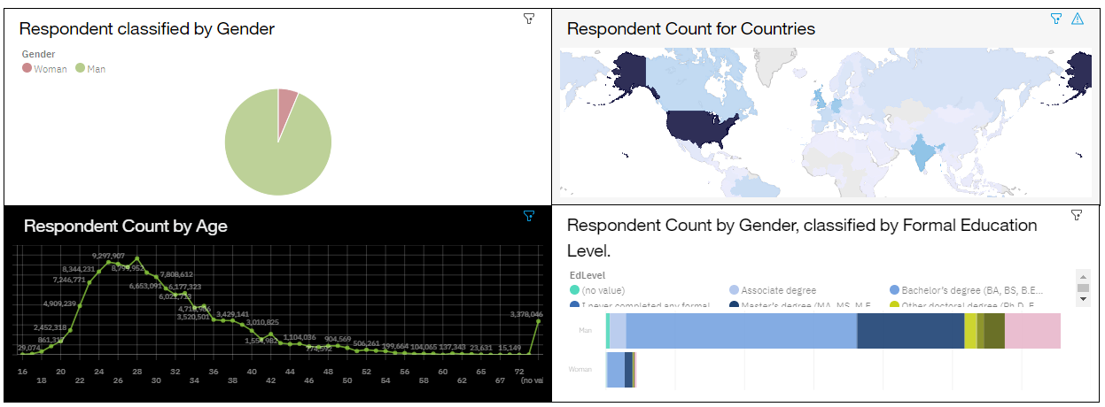
DASHBOARD TAB 3

Slide 15
DISCUSSION
Difference in Technology Usage Trend Now and in the Future
Gender, Age and Education Discrimination in the IT Industry

Slide 16
OVERALL FINDINGS & IMPLICATIONS
Findings
Technology trends changes every year
USA is the top technology country
There are extreme gender and age discrimination
Docker and AWS are the most popular platform
Implications
Programmers should always follow the latest technology trends
More countries should have an equal chance to be exposed to new technology
Gender and Age should not be one of the concerns or benefits of Employment

Slide 17

CONCLUSION
Technology Trends
Programming Languages, Database, Platform, and Web Frame Trends
Demographics Trends
Gender, Age and Education
Programming Languages Trends and Salary Trends

Slide 18

APPENDIX
IBM Cognos Dashboard Embedded (CDE) is an AI-fueled business intelligence service that supports the entire data analytics cycle, from discovery to operationalization. With the help of its data discovery tools, users can visually examine and engage with their data to find the most important insights for making better data-driven decisions. Without previous expertise, users may uncover data and easily put that information together into visually appealing, interactive dashboards.

Slide 19
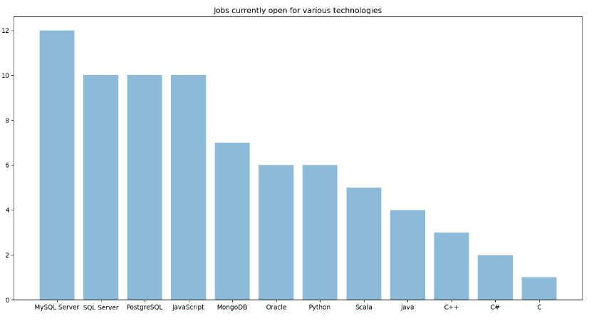
JOB POSTINGS

Slide 20
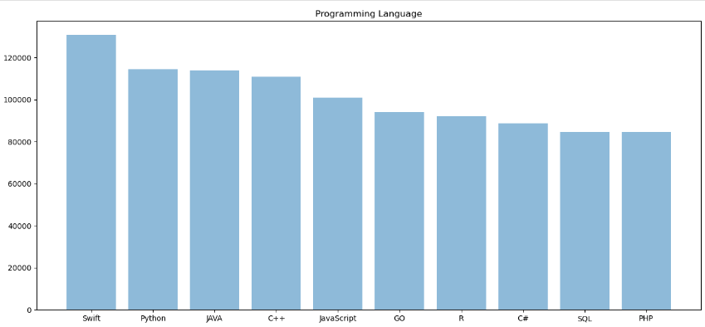
POPULAR LANGUAGES

